Slide 1
B37VB2
C Programming for Engineers
Unit 1f: Introduction to Visual Studio 2013

Slide 2
AIMS
In this unit, we will be considering the following topics:
  How to use the Microsoft Visual Studio 2013 programming environment installed in E101 to create and run C programs.

Slide 3
Getting Started - Running Visual C++
To use the VS package, first log on to one of the PCs.
The VS2013 program locates in the “Start -> All Programs -> Microsoft Visual Studio 2013->Visual Studio 2013.
If you cannot find it, ask for help immediately

Slide 4
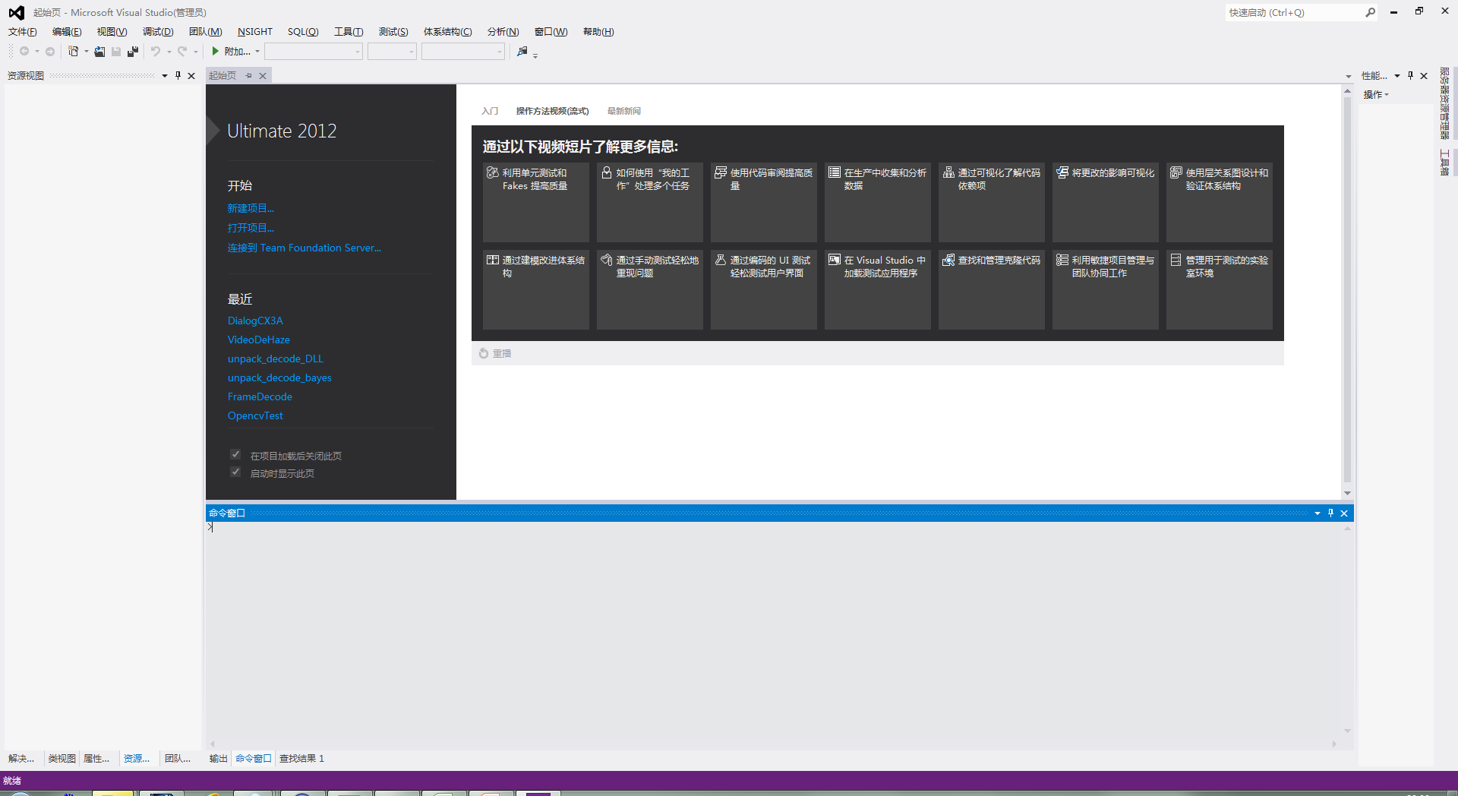
Using the VS2013
The following window will appear on your desktop:

Slide 5
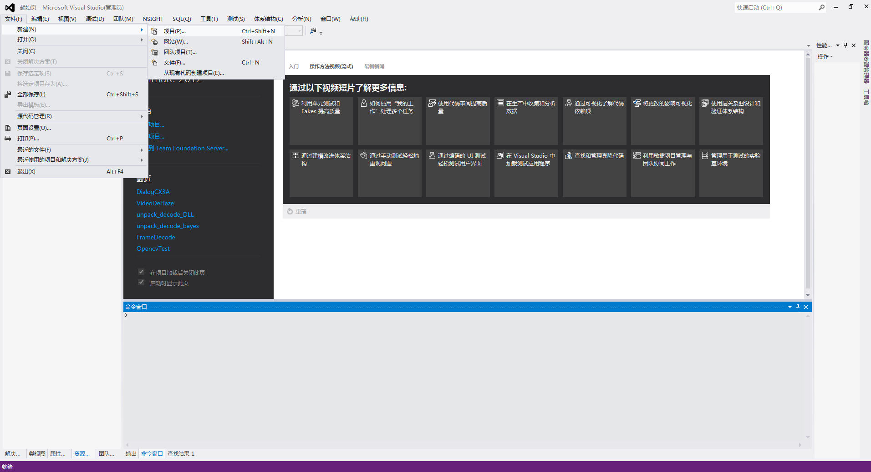
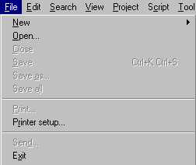

Opening a new "project"
VS2012 stores all information about a program in a "project file".
  To create a new project file, click on File in the menu bar.
  Select New on the drop down menu and select Project.

Slide 6
The VS2013 "project"
The "project" is a feature VS2013 that is used to organise all the different files required by a single program.
  We shall see later, that it is possible to split one C program over a number of different files.
  The idea of a project is entirely to do with the package that we are using, and has nothing to do with the C programming language.
  When you create a “project” you will also create a “solution” . Solution files are terminated in the file extension “.sln“. You can create a number of projects in one solution.

Slide 7
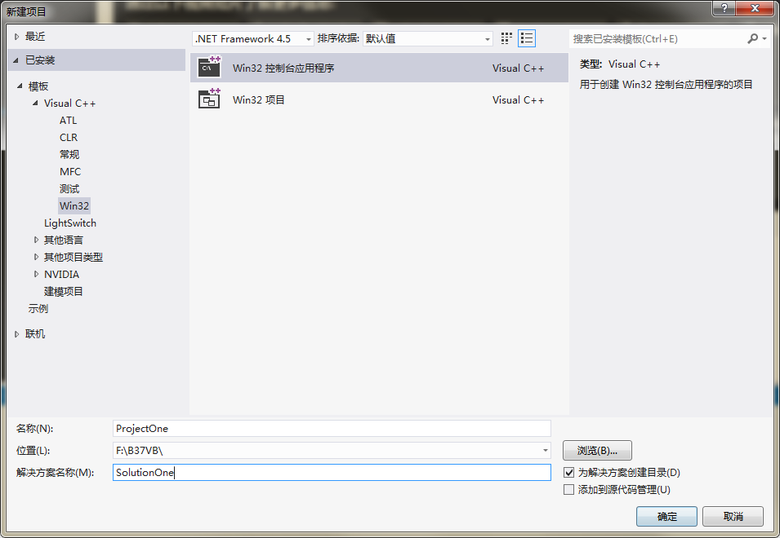
Creating a project
A dialogue window will appear, as shown below:
1
There are 2
points to note:
2

Slide 8
Creating a project
  The “Project Type"
  All of the programs that we shall write will have the " Win32 Console Application" project type.
  The project path and name
  A path is the directory where the project file is stored. The default path is “F:\B37VB\" where F: is your "root" directory and B37VBis the directory containing the VS2012 C source files. You can type in the name of a new directory (e.g. “F:\mine\" ) if you prefer. VS2012 will create this directory.
  The package will provide a default project name (e.g. MyConsoleApplication). You may provide your own name (e.g. “ProjectOne" ).
1
2
NOTE: All directory and file names used in VS2012
should obey the Windows naming convention :-
use only letters, digits, and the underscore character "_" .

Slide 9

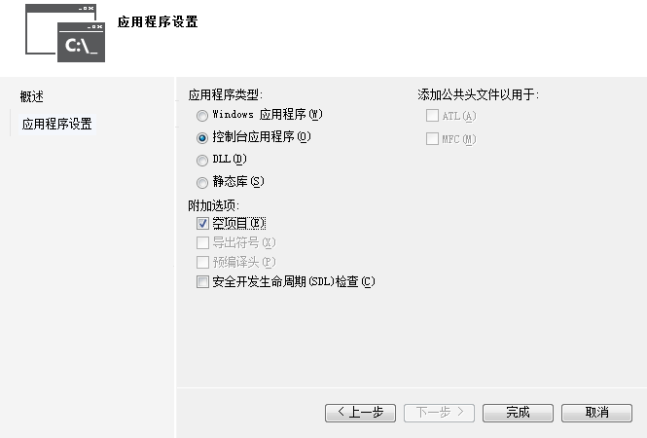
Creating an empty project

Slide 10
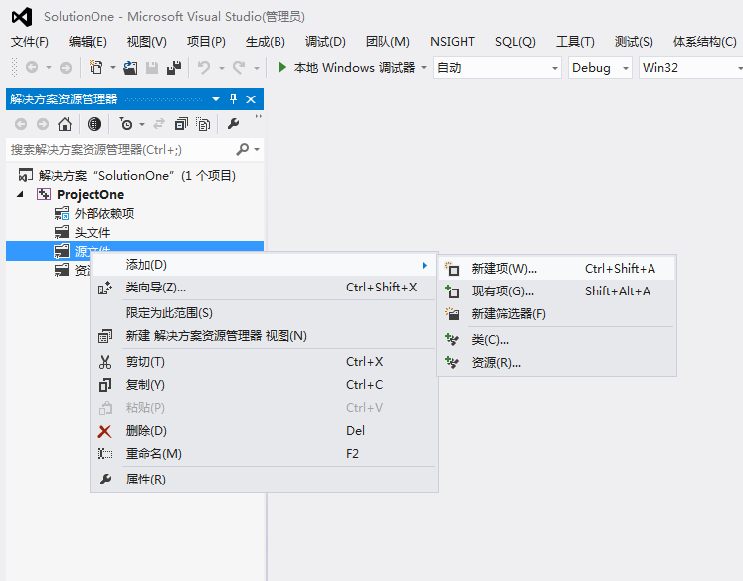
Add a new source file

Slide 11
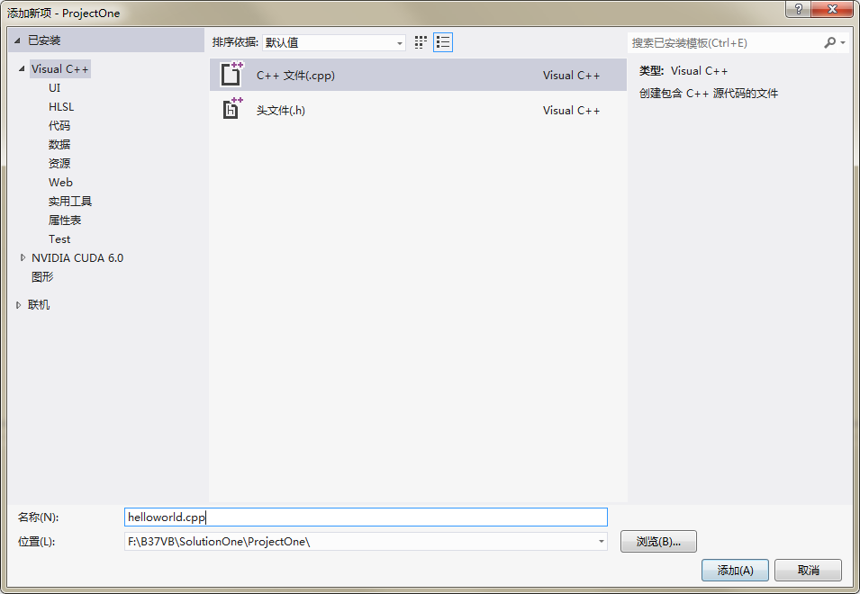
1

Slide 12
  Compiling C on the VS2013 C++ compiler
  As indicated by its name, VS2012 C++ is actually a C++ compiler. C++ is a programming language that was developed from C. To make the package pretend that it is actually a C compiler, we need to change the suffix of your new file from “.cpp” to “.c”.
1

Slide 13
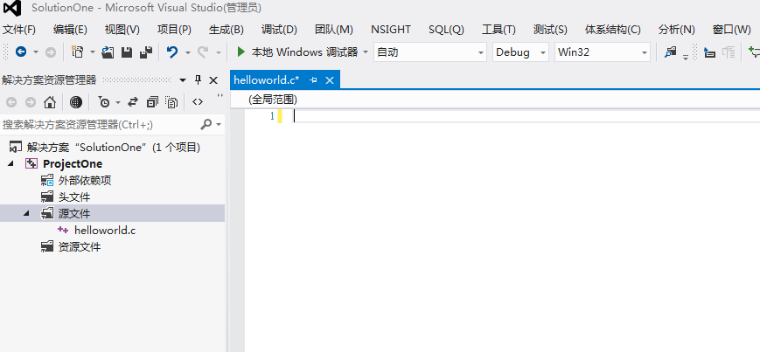
Editing the program
You will be presented with a solution window, containing icons for the files helloworld.c.
editor window
appears
2
1
click
helloworld.c

Slide 14
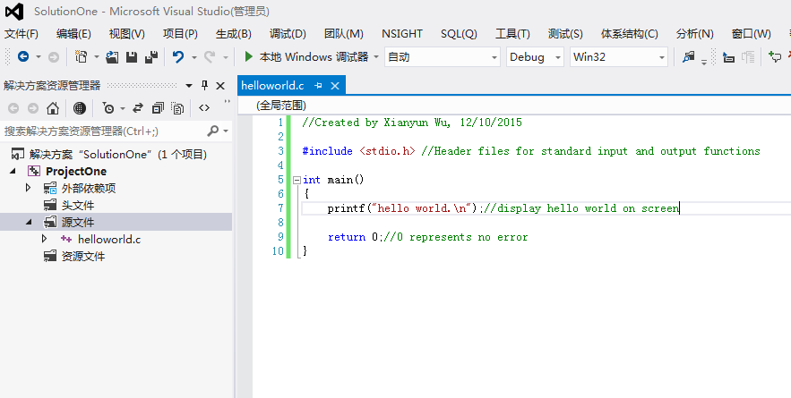
Edit the source code
When the editor window appears, simply type in the text of your program.

Slide 15
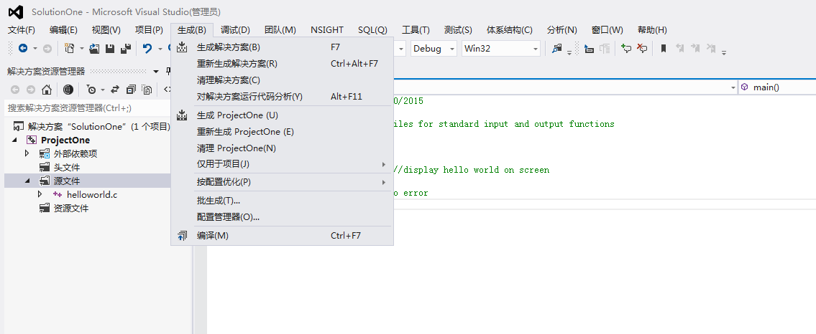
Compiling and Running
To compile and run your program, choose the “build” menu and click the “Compile” or “Build solution”.
  A window appears indicating that the program is being compiled and linked.
click
click

Slide 16
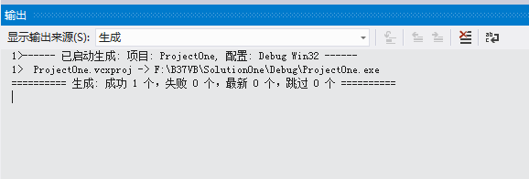
Program execution
If there are no errors, the output window will display build success.
Any errors are
displayed in
this window.

Slide 17
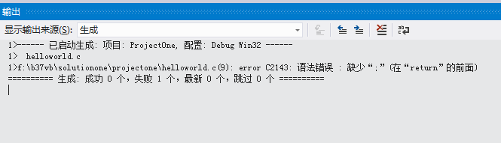
Error reporting and locating
If there is a problem with your code, the output window will display errors:
Build failed with 1 error
Error information is listed here.
Error line is 9.
Error code is C2143.

Slide 18
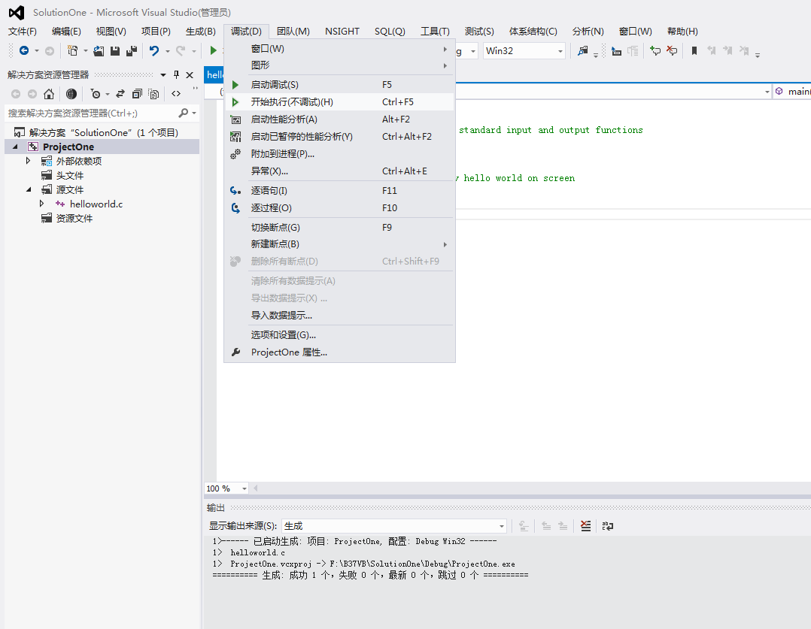
Excute your project
Choose the “Debug” menu and click “Start excution without debugging”.

Slide 19
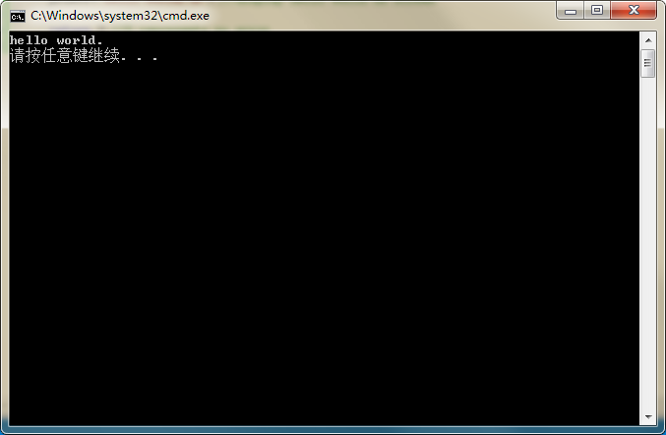
Console application window
After you excute your program, there will pop up a window displaying your output.
Program input
and output takes
place in window.

Slide 20
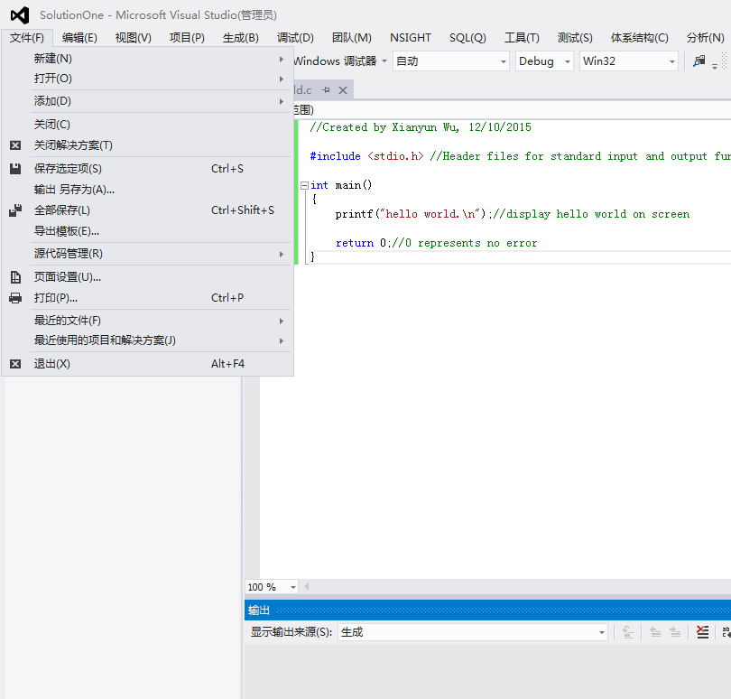
Saving and quitting
Once you have entered and run a program, you can save it and quit the package.
To save
project
click Save
To exit
package
click Exit

Slide 21

Opening an existing project
To open an existing project, start Borland C++ as before and select Open project under the Project menu item.

Slide 22
Homework
What’s the difference between C project and C++ project?
What other project types can you created in VS2013?
How to debug a program if your code has a bug?

